Slide 1


The 5 Before
Thursday 22
Case – A Rush to Failure. In the HBR Guide
Discussion on MTH 3 & 4
Review Chapters 1&4 MS Project 2010
DUE: Teams Selected in Blackboard

Slide 2
Begin at the Beginning
What is a Project?
A project is a temporary endeavor undertaken to create a unique product, service or result.¹
A project is a set of tasks with a beginning and an end with the purpose of delivering a result which provides value.
Key Attributes
A project has a beginning and an end – Finite
A project delivers some result
A project provides value
1. Strategic Leadership of Portfolio and Project Management, p4

Slide 3
The Triple Constraints a.k.a. The Iron or Trade-off Triangle
Time
(Schedule)
Cost
(Budget)
Scope
(Requirements )
Notes:
Scope/Product corner includes quality and all other product-related attributes including features, complexity, usability, modifiability, maintainability, defect rate, etc.
Objective is to balance the triangle; if you want to load up the product corner, then you have to load up cost, schedule or both
Let customers hold the corner(s) that they want to control; developers have to have at least one corner to hold on to
~30-40% of all development projects suffer from simultaneously dictated features, resources. And schedules (McCarthy 1995).
Customer with all corners usually means 10-pound product in a 5-pound sack

Slide 4
Looking back to go forward
Project Management is not a sacred art.
The simpler your view, the more power and focus you will have.
Simple doesn’t mean easy.
“Human beings, who are almost unique in having the ability to learn from the experience of others, are also remarkable for their apparent disinclination to do so” – Douglas Adams
“Experience alone doesn’t make you better at anything. Evaluated experience is what enables you to improve your performance.” - Andy Stanley
Learn as much as possible from other people’s failure
Notes:
We want to (re)use as much knowledge as we can. “there isn’t anything new under the sun” Use the model from caribou coffee. New foods and services. Most problems/challenges we have face patterns that have happened before.
This is the idea of the beginners mind. There are a few strategies, even for advanced professionals to come to a new role with a freesh view. When you have a boss roll in (new to the team) how do you feel when they act like they know everything?
Who can explain this for me?
Example of boot-camp getting dressed by the numbers

Slide 5
The role of project management
Leading a team in figuring out what the project is (planning scheduling…)
Shepherding the project through design (communication and mid-game ***)
Driving the project to completion
Planning
Build-up
Implementation
Closeout
Notes:
The role of the PM falls into these main three categories.
How does this compare to the phases of project Management as defined by HBR?

Slide 6
The Project Management Paradox¹
Ego/no-ego
Autocrat/delegator
Tolerate ambiguity/pursue perfection
Oral/written
Acknowledge complexity/champion simplicity
Impatient/patient
Courage/fear
Believer/skeptic
“Pursuing the Perfect Project Manager” Tom Peters
Notes:
this is what happens when a tornado meets a volcano
Brave feel no fear…brave are afraid and do it anyway
What is the difference between a cynic and a skeptic?
Impatient/ patient – the the process flow – running back example.
Courage/fear -
A skeptic asks good questions, they probe to get to the answer. The

Slide 7
Tensions of a Project Manager
Success requires change – you must reject passivity – stay in the middle.
Process vs Goals
Adherence to a checklist implies a particular process guarantees an outcome – this is never the case.
End the end there are only three things
1) A goal
2) A pile of work
3) A bunch of people.

Slide 8
PM has unique value to add
Project Managers or leaders spend more time with each person on the team than anyone else.
What does this statement mean?
How does it apply to:
Work ethic?
Climate?
Commitment?
Notes:
What does this statement mean? How does this apply to

Slide 9
Take a sec (or a few minutes)
Take a minute to think about a project you worked on that failed.
List mistakes you made and what you’d do differently the next time.
Be prepared to share it.

Slide 10
Phases of Project fManagement
Planning
Build-up
Implementation
Closeout
1. Strategic Leadership of Portfolio and Project Management, p4

Slide 11
Planning
Activities
What is the real Problem
Who are the stakeholders
Define the Objectives – Exit Criteria
Determine Scope
Prepare for Trade-Offs
Key Skills
Planning
Cost-Benefit Options
Task
Tools
WBS/RBS
Source - HBR Guide to Project Management

Slide 12
S.M.A.R.T. Goal Setting
Project/Program objectives should follow the SMART model.
Specific
Measurable
Action-oriented
Realistic
Time-limited

Slide 13
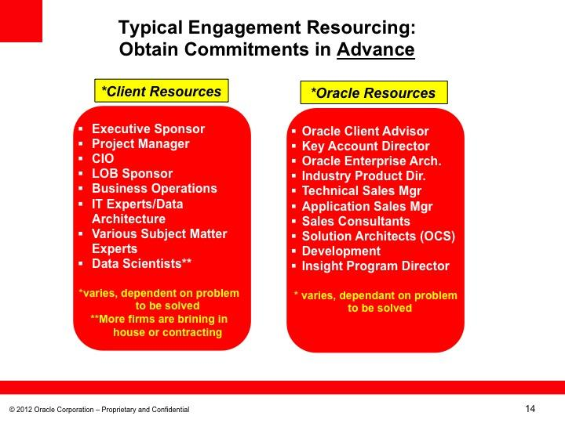
Real World
Source - HBR Guide to Project Management

Slide 14
Build-Up
Activities
Assemble the team
Plan assignments
Create Schedule
Hold a Kick-Off meeting
Key Skills
Delegating
Negotiating
Recruiting
Communication
Tools
Scheduling Tools – IE, MS Project, Trillo, Monday.com Tomsplanner.com
Source - HBR Guide to Project Management

Slide 15
Implementation
Activities
Monitor and Control
Report Progress
Team Meetings
Manage Problems
Key Skills
Leading
Conflict Management – Set the rules of engagement
Communication
Problem Solving
Tools
Meeting Notes – IE Minutes
Source - HBR Guide to Project Management

Slide 16
Closeout
Activities
Evaluate
Close
Retrospective
Feedback
Key Skills
Follow-through
Planning
Leadership
Communication
Tools
Retrospective
Source - HBR Guide to Project Management

